Slide 1


P.A.COLLEGE OF ENGINEERING AND TECHNOLOGY Accredited by NAAC with ‘A’ grade DEPARTMENT OF ELECTRONICS AND COMMUNICATION ENGINEERING VEHICLE CONTROL SYSTEM IMPLEMENTATION USING CAN PROTOCOL
Presented by, Guided by,
R.P.Anusubhashini (721714106008) Mr. R. Vishnu Vardhan,
R.Carolene Prem Leela (721714106018) Assistant Professor,
M.Kiruthika (721714106049) Department of ECE.

Slide 2
OBJECTIVE
To Implement the control system for vehicle using CAN protocol with ultra low power consuming TI controller and low cost Micro Chip Transceiver.

Slide 3
ABSTRACT
Automobile Automation is a growing field which focuses on power, cost, fuel and time efficiency of the system. All modern vehicles today include an Engine Control Unit (ECU).
This project aims in designing ECU of the vehicle using ultra low power consuming MSP430 and high data rate transmission CAN Protocol.

Slide 4
LITERATURE SURVEY
S.No | Title of the paper and author Name (Year) | Methodology | Merits | Demerits
1. | Automatic control system by Benjamin C Kuo [2003]. | PID using controller | High speed | Electrical noise
2. | Trends in Automotive Communication Systems by Prodanov. W [2005]. | Vehicle speed estimated by the engine controller or by wheel rotation sensors | More flexible, dynamic part communication cycle | low computational power, small amount of memory

Slide 5
LITERATURE SURVEY
S.No | Title of the paper and author Name (Year) | Methodology | Merits | Demerits
3. | Calculating CAN message response times by Tindell . K[2006]. | A station on a CAN bus is able to receive a message based on the message identifier. | Immediate re-transmission | Worst –case response of a given message.
4. | Embedded system design for automotive Application by Wilfried Voss [2007]. | Automatically map a set of tasks onto the platform, guaranteeing the correct functionality and timing with optimal resource utilization. | high-speed, highly deterministic communication. reliability, ﬂexibility, and extensibility | complex subsystems, high distribution, complexity, and interoperability.

Slide 6
LITERATURE SURVEY
S.No | Title of the paper and author Name (Year) | Methodology | Merits | Demerits
5. | Vehicle control system implementation Using CAN protocol by Vijayalakshmi.S[2013]. | Using ARM as the main controller. | Low cost, high –performance, high speed. | Power consumption.
6. | A CAN protocol based embedded system to avoid rear-end collision of vehicle by Pazul [2015]. | IR communication to communicate with the trailing vehicle to warn the driver and take proper control action to avoid the rear-end collision. | Lower cost, cheaply available. | Difficult to implement.

Slide 7
EXISTING METHOD
ANALOG DISPLAY
ECU
(ARM,SPI)
CONTROLS

Slide 8
EXISTING METHOD
The MCP2551 is used as the main controller of USB-CAN smart card. Its 8-bit data bus interface PORT A is used to communicate with PDIUSBD12 .
The only draw back of the existing system in Power consumption which has be solved using ultra low power controller.

Slide 9
NAME OF THE PROPOSED METHOD
ANALOG DISPLAY
ECU
(MSP430,CAN)
CONTROLS

Slide 10
VEHICLE CONTROL SYSTEM IMPLEMENTATION USING CAN PROTOCOL
Temperature sensor
MSP430G2 (Master)
CAN
Transceiver
C
A
N
B
U
S
Rain water sensor
Fuel level sensor
Buzzer
MSP430G2
(Slave)
CAN
Transceiver
Wiper control
Coolant Fan

Slide 11
CIRCUIT EXPLANATION
There are master and slave modules in this vehicle control system implementation. In master module, sensor has been interfaced. Analog sensors like Temperature sensor and Rain water sensor which are connected to ADC ports,
Where the Analog values are converted into digital.MSP430G2553 has a10 bit ADC, so the maximum precision is 1023 as digital value .Digital sensor like Fuel level sensor is used.

Slide 12
CIRCUIT EXPLANATION
The serial monitor in ENERGIA can display the digital values of the sensors, provided com port of the USB and device should be similar, Baud rate of the controller terminal should be 9600Hz and tool selection should be made. Through receiver which is slave module the data’s are displayed in serial monitor.

Slide 13
COMPONENTS SPECIFICATION
MSP430G2553 Launch Pad(2).
MCP2551 CAN Transceiver(2).
Temperature Sensor (LM35).
Rain water Sensor.
Water level Sensor.
RS 232 Serial Port.
7805 Voltage Regulator.

Slide 14
RESULTS POWER REPORT
Current(uA)
Tpro(ms)

Slide 15
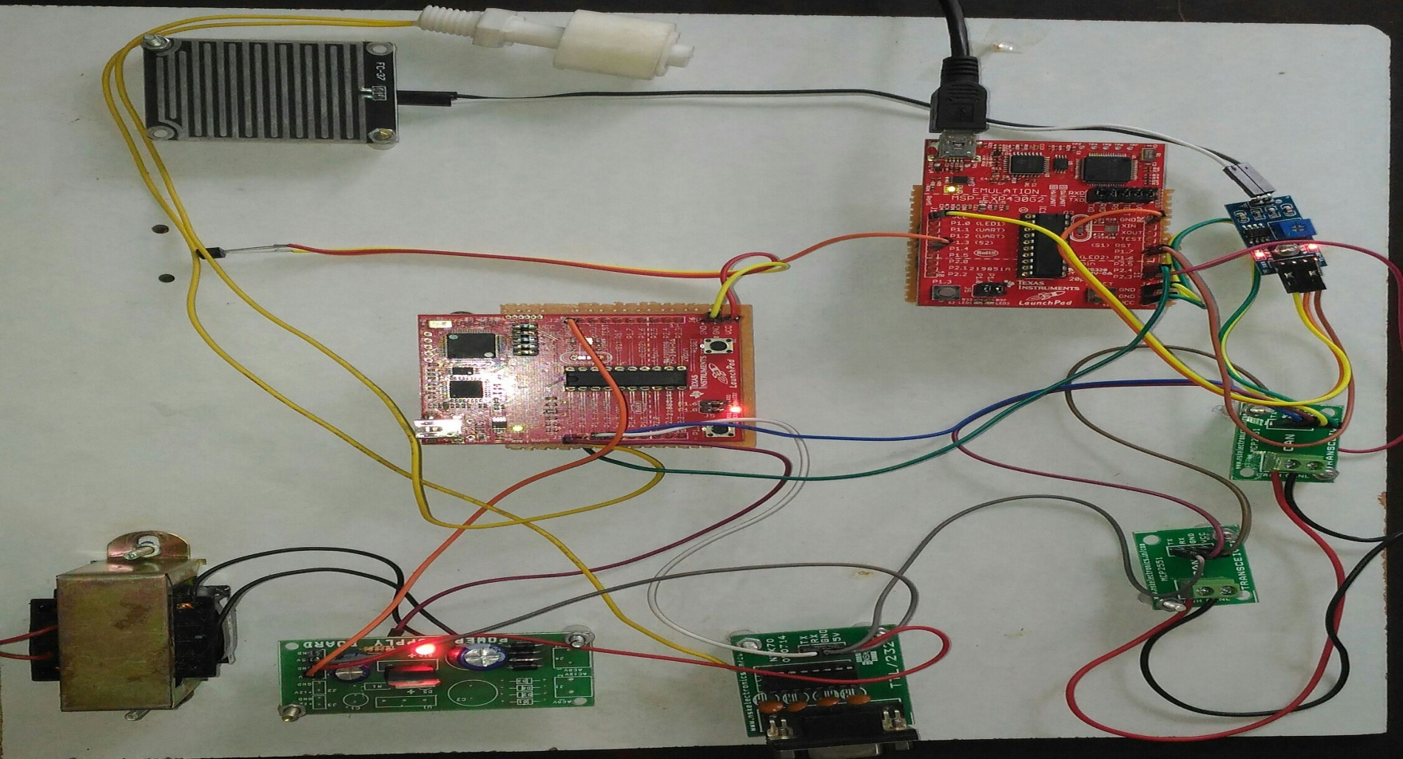
RESULTS

Slide 16
SUMMARY AND FUTURE ENHANCEMENT
Thus the Engine Controller Unit for Automobile is designed using TI Controller if future it can be further improved by moving all the parameters sensed to an automotive domain of driver less automobiles.

Slide 17
REFERENCES
Vijayalakshmi,S. “ Vehicle control system implementation Using CAN protocol”. IJAREEIE, Volume 2, Issue 6, June 2013.
Kumar, M. A.Verma, and A. Srividya, Response-Time “Modeling of Controller Area Network (CAN). Distributed Computing and Networking, Lecture Notes in Computer Science Volume 5408, p 163-174, 2009.
Li, M., Design of Embedded Remote Temperature Monitoring System based on Advanced RISC Machine. Electrotechnics Electric, 06, p. 273, 2009.
Prodanov, W., M. Valle, and R. Buzas, A controller area network bus transceiver behavioral model for network design and simulation. IEEE Transactions on Industrial Electronics, 56(9): p. 3762-377, 2009.
Wilfried Voss, A comprehensive guide to controller area network, Copperhill Media Corporation, 2005-2008.
Tindell, K., A. Burns, and A.J. Wellings, Calculating controller area network (CAN) message response times. Control Engineering Practice, 3(8): p. 1163-1169, 2005.
Benjamin C Kuo, M. Farid Golnaraghi,Automatic Control systems, Eight edition, John wiley & sons., Inc 2003.
Pazul, “Controller Area Network (CAN) Basics”, Microchip technology Inc., AN713, May 1999.
ISO (1993). Road Vehicles: Interchange of Digital Information: Controller Area Network (CAN) for High Speed Communication. ISO 11898:1993.
B.Gmbh, “CAN specifications” vol 1 Version 2.0, 1991.

Slide 18
QUERIES ?

Slide 19
THANK YOU

